Slide 1
GPP Exam: Zombie AI

Slide 2
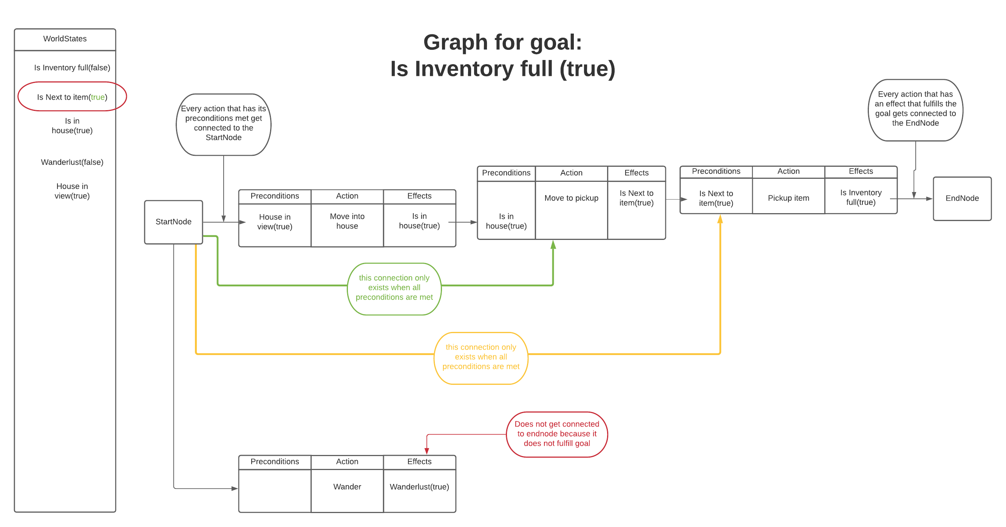
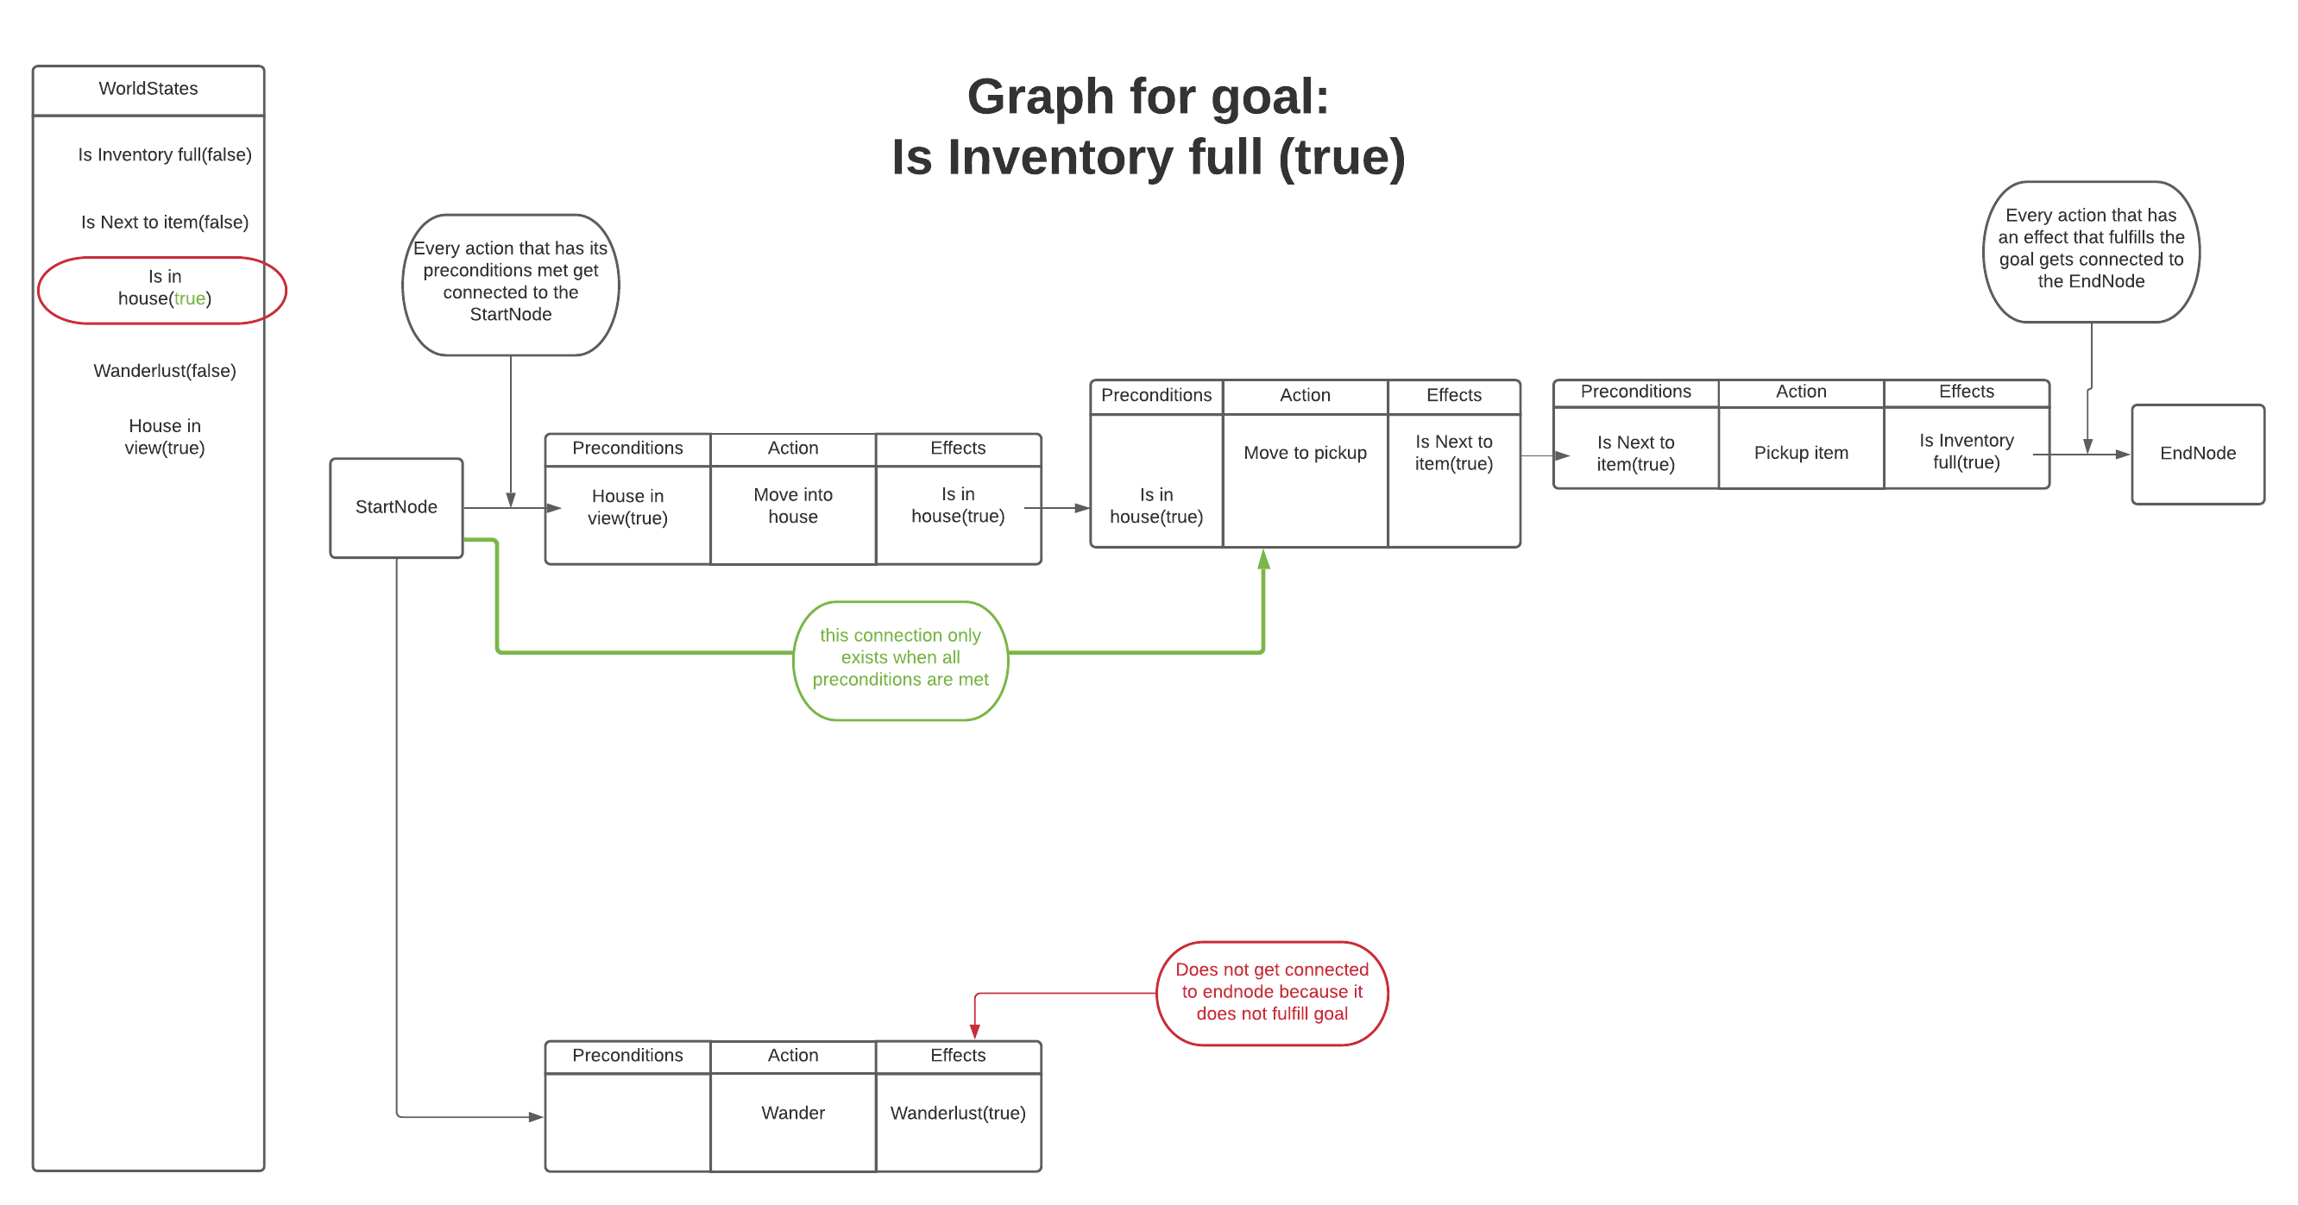
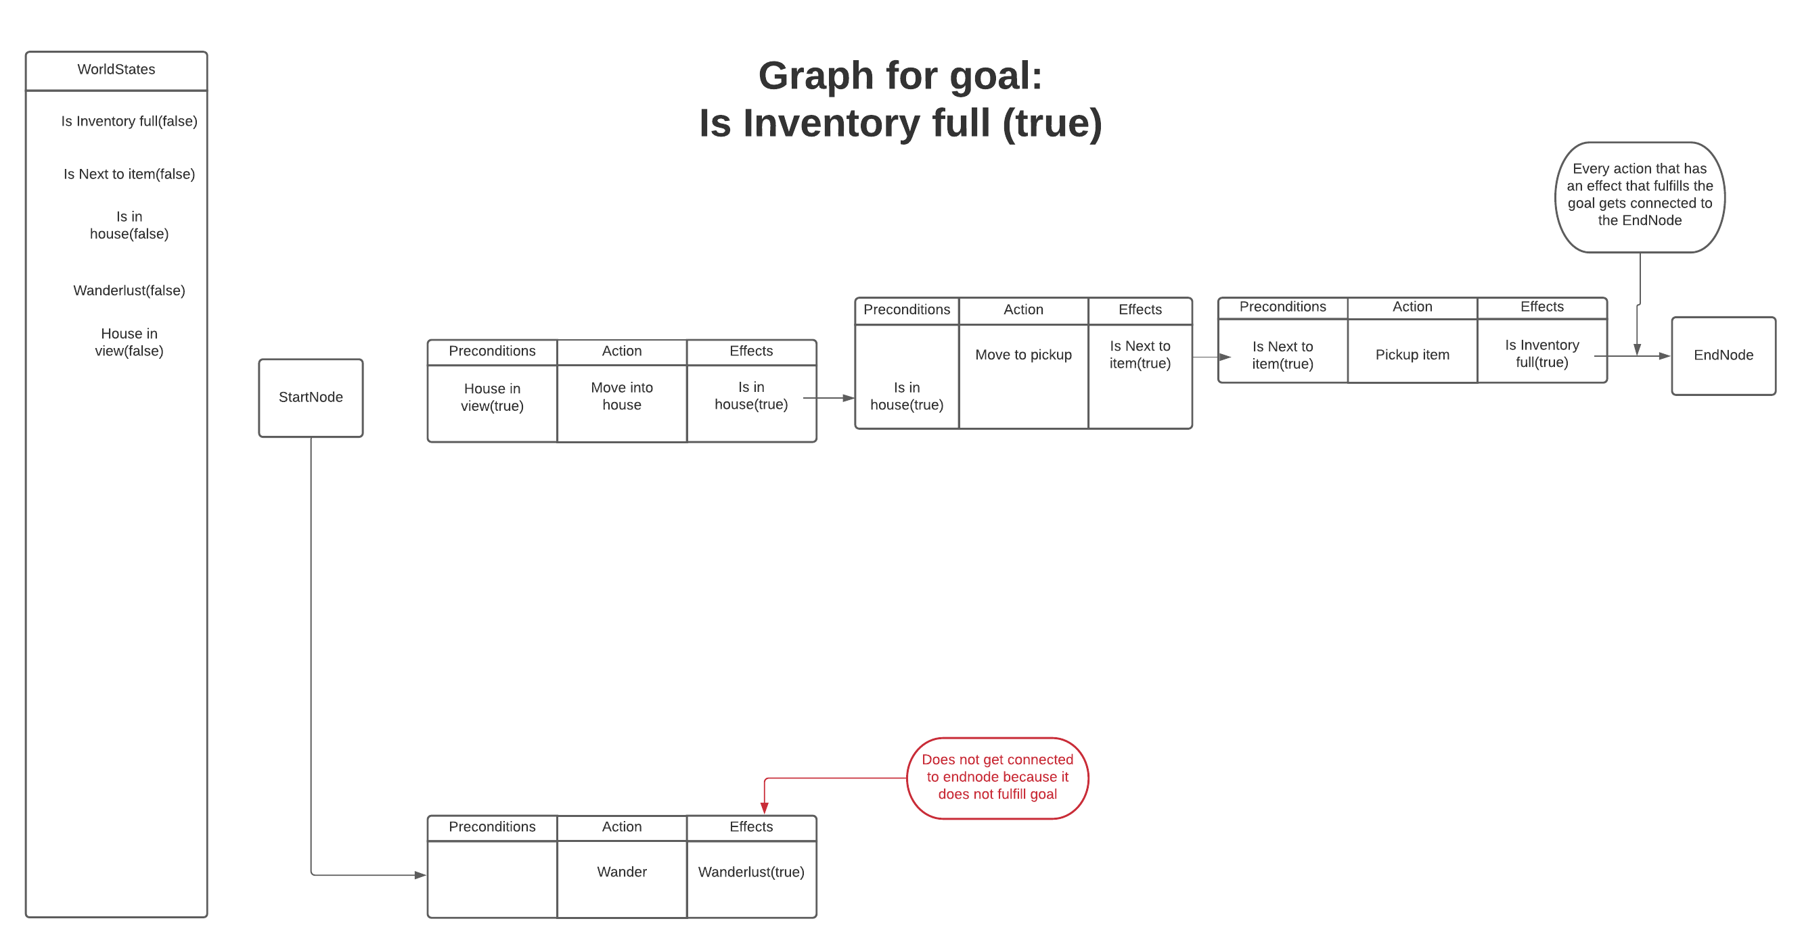
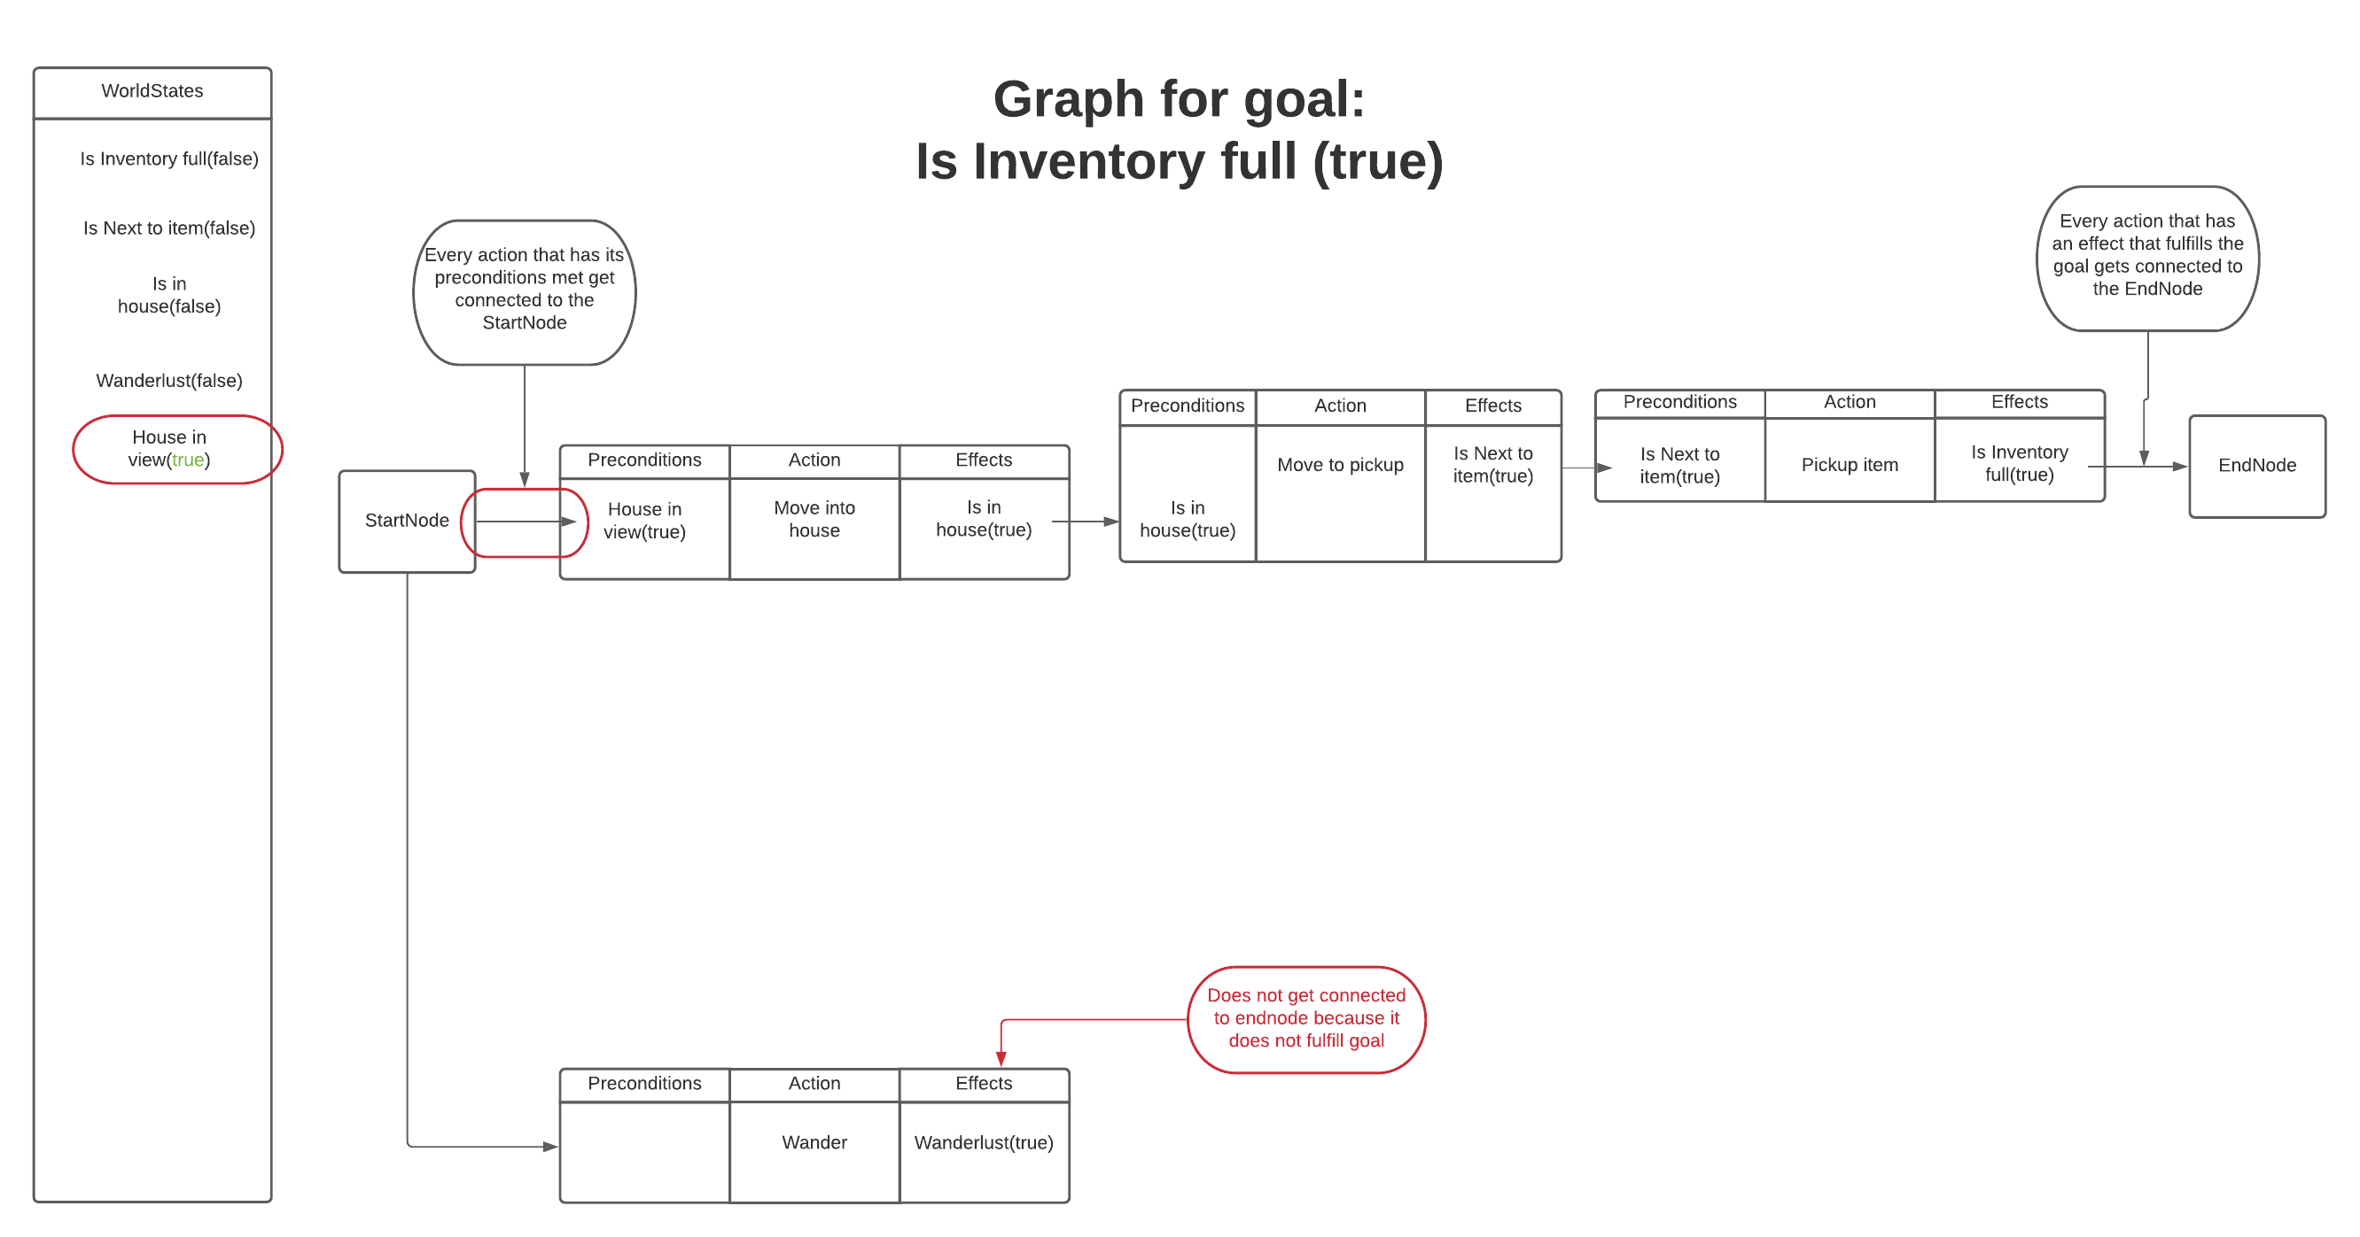
Decision Making

Slide 3
Enemy handling
Running backwards
Running when bitten
Facing an enemy and shoot

Slide 4
Inventory
Any item appearing in FOV gets remembered
Agent will go towards closest remembered item
Agent will always pick up the item
Duplicates or useless items get used or discarded
Agent uses medkits and food whenever falling below set threshold

Slide 5
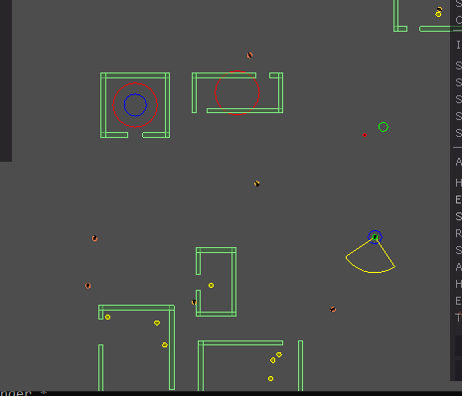
Movement & exploration
Wander is simply heading in random direction
Direction gets changed on any of these conditions:
Has wandered too long
Agent went out of bounds
Agent or wander target is in purge zone
Goes to the center of any house that comes in view
Every house gets remembered for a set amount of time
Remembered houses get ignored
Every action has its own custom steering behaviour -> goap

Slide 6
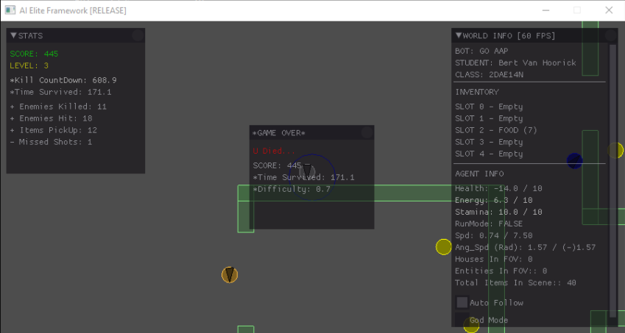
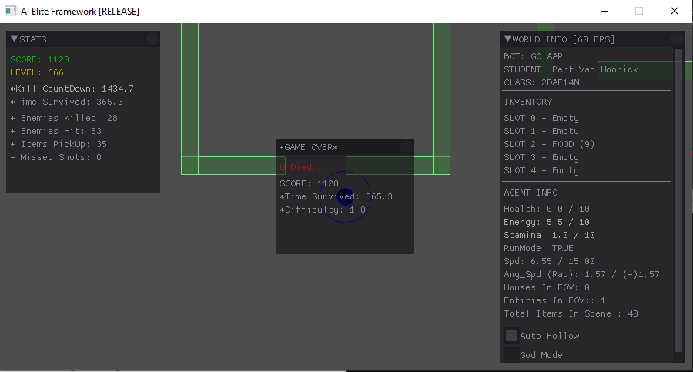
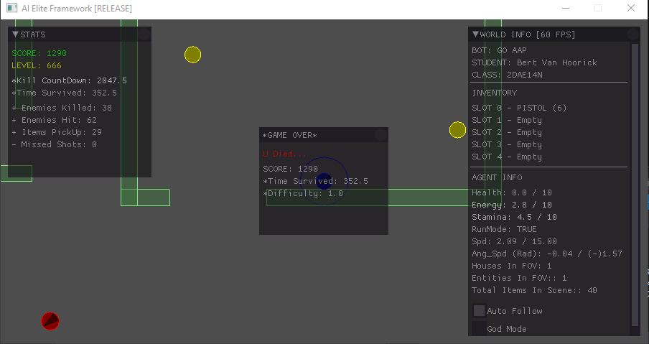
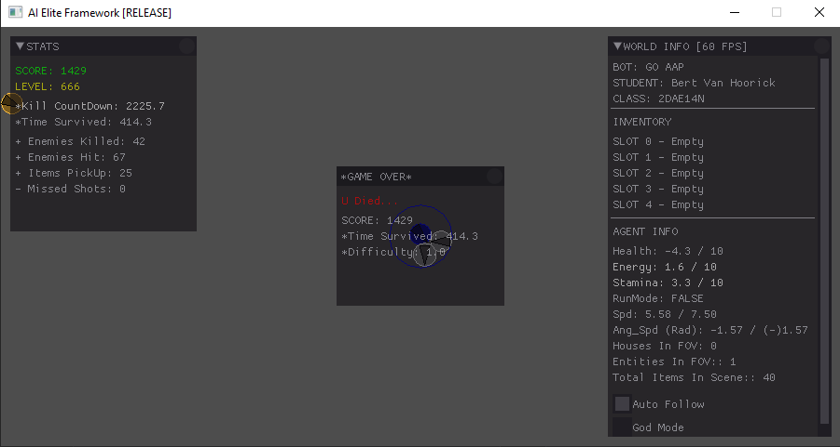
High scores

